Slide 1
More than the Rainbow!
Yerkes – Saturday, March 11th
I have sent a link to the email address you provided:
https://www.eisacademy.org

Slide 2
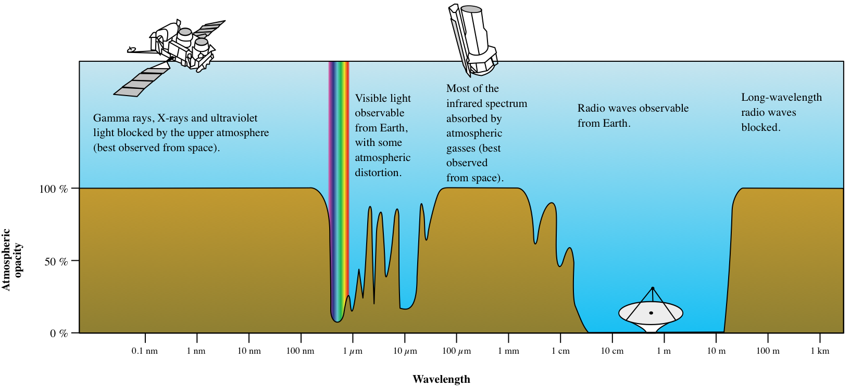
As of now, our only connection to the cosmos is the waves that come to us as part of the electromagnetic spectrum.
Gravity waves will give us an additional and different view in the future!
This workshop offers a glimpse of how astronomers study these waves to gain more understanding of the universe,
Specifically, we will discuss:
Radio
Microwaves/submillimeter
Infrared
Visible light/ultra violet

Slide 3
Schedule for the day:
Introduction to each other
Intro to spectrum (a course in the EIS academy)
Presentations by Marc Berthoud
How scientists get data from telescopes (satellite or earth bound) – an Imagine the Universe web page – Kathy Gustavson
A little more info on Radio/Microwave waves - Kathy Gustavson
Lunch
Infrared astronomy – Kevin McCarron
Visible light and UV – Rich DeCoster
Wrap up

Slide 4
Please help yourself to the things on the back table . . .
NASA is not handing out too many things
The stuff in the back was picked up by people who went to the AAS meeting
Also help yourself at any time to the snacks!
Note: The other power points and resources will be added to the EIS Educator Development page after the workshop.

Slide 5
An overview of the spectrum
An online course module for students from the EIS Academy
https://www.eisacademy.org

Slide 6
Marc Berthoud

